Slide 1

4. Analysis of IR Spectrum
The degree of unsaturation.
Chemical bonds and functional groups.
Derivatives and substitutions.
Compare with the standard spectrum.
Cooperate with other analysis methods.

Slide 2
Six IR regions:
4000-3000cm⁻¹ ν _{X-H} : -OH, -NH, -CH (Unsaturated)
3000-2500cm⁻¹ ν _{X-H} : -OH, -NH, -CH (Saturated)
2500-2000cm⁻¹ ν _{CΞC} and ν _{C=C=C} : Alkynes, Nitriles.
2000-1500cm⁻¹ ν _{C=O} and ν _{C=C} : -C=O, -C=C, Phenyl, C=N、N=O.
1500-1300cm⁻¹ δ, γ_{C-H} For alkyl chains
1300-400cm⁻¹ δ, γ_{C-H ,}ν _{C-O} : Benzene substitution, alkene conformation messages

Slide 3
Practice 1：C₇H₈O

Slide 4
Step 1：
Unsaturation f= 1+7+1/2(0-8)=4
Phenyl group, possibly
Step 2：
3039cm⁻¹，3001cm⁻¹ υ_{=C-H}，-C=C-H
2947cm⁻¹ υ_{-C-H ，}-C-C-H
1599cm⁻¹，1503cm⁻¹ υ_{phenyl c=c ，}Phenyl (4 saturations)
1248cm⁻¹,1040cm⁻¹ υ_{C-O-C ，}Ether
756cm⁻¹，694cm⁻¹ γ_{phenyl =C-H}，Mono-substitution of phenyl

Slide 5
Step 3：
The structure goes to…

Slide 6
Practice 2: C₈H₇N

Slide 7
Step 1：
Unsaturation f= 1+8+1/2(1-7)=6
Phenyl, possibly
Step 2：
3062cm⁻¹ υ_{=C-H}，-C=C-H
2924cm⁻¹ υ_{C-H ，}-C-C-H
2229cm⁻¹ υ _{C ≡N，}-CN (2 saturations)
1589cm⁻¹，1481 cm⁻¹ ，1458cm⁻¹ υ_{phenyl C=C ，}Phenyl (4 saturations)
1381cm⁻¹ δ_{s CH3，}-CH₃
787cm⁻¹，687cm⁻¹ γ_{phenyl =C-H}，meta-disubstitution of phenyl

Slide 8
Step 3：
The structure goes to…

Slide 9
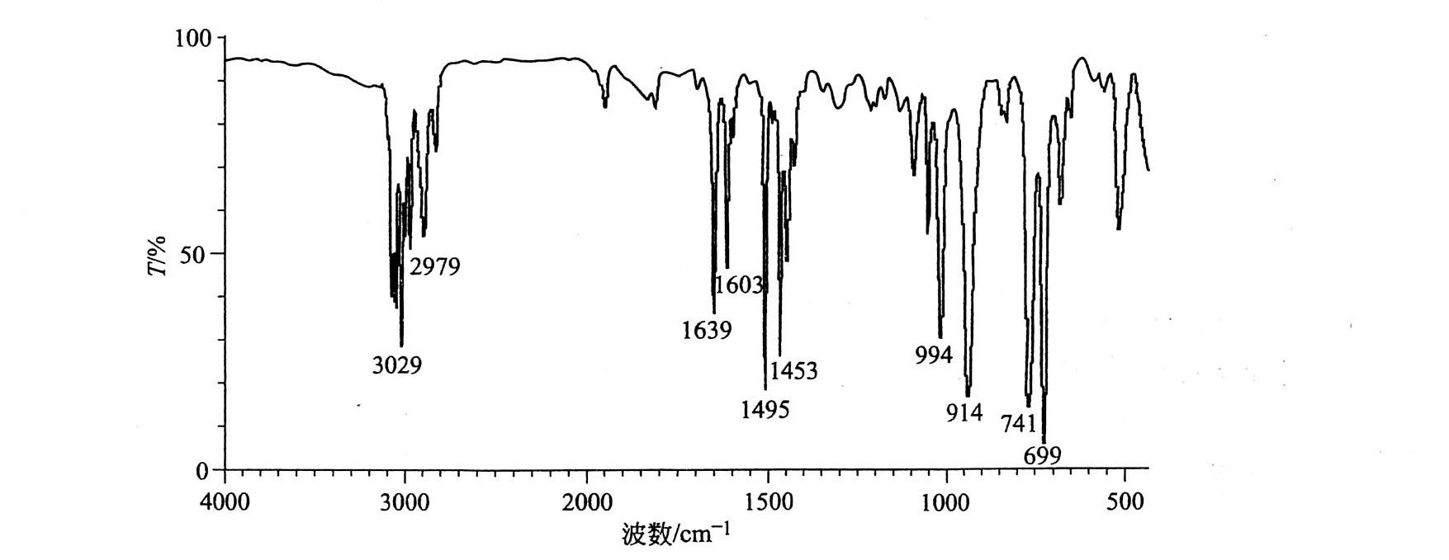
Now it is your turn…
Practice 3: C₉H₁₀

Slide 10
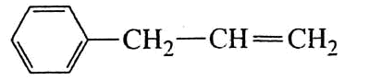
Unsaturation=1+9+（0-10）/2=5
Phenyl possibly
3029 cm⁻¹ ν _{=C-H}, -C=C-H
2979 cm⁻¹ ν _{-C-H}, -C-C-H
1639 cm-¹ ν _{–C=C}, -C=C- (1 saturation)
1603cm⁻¹，1495 cm⁻¹，1453cm⁻¹ υ_{phenyl C=C ，}Phenyl (4 saturations)
990cm⁻¹，914 cm⁻¹ γ_{=C-H}, RCH=CH₂
741cm⁻¹，699 cm⁻¹ γ_{phenyl =C-H}，Mono-substitution of phenyl

Slide 11
5. IR Instruments and Technology
IR Spectrometers
Dispersive infrared spectrometer
Fourier transform infrared spectrometer (FTIR)
IR Measuring Technology --- Sample Preparation

Slide 12
Fourier transform infrared spectrometer
(傅里叶变换红外光谱仪)
光 源
干 涉 仪
检 测 器
傅里叶变换计算机
样 品
干涉图
光谱图

Slide 13
Advantages for FTIR
1. Fast
1s to get an IR spectrum
several minutes for dispersive IR
2. High resolution and sensitivity
3. High accuracy
resolution of wave number to 0.01 cm⁻¹

Slide 14
Sample Preparation
Gas sample：Gas cell
Liquid sample：Film method, Coating method
Solid sample： Tabletting method, Paste method, thin film method
Special sample： Attenuated Total Reflectance, ATR

